Slide 1
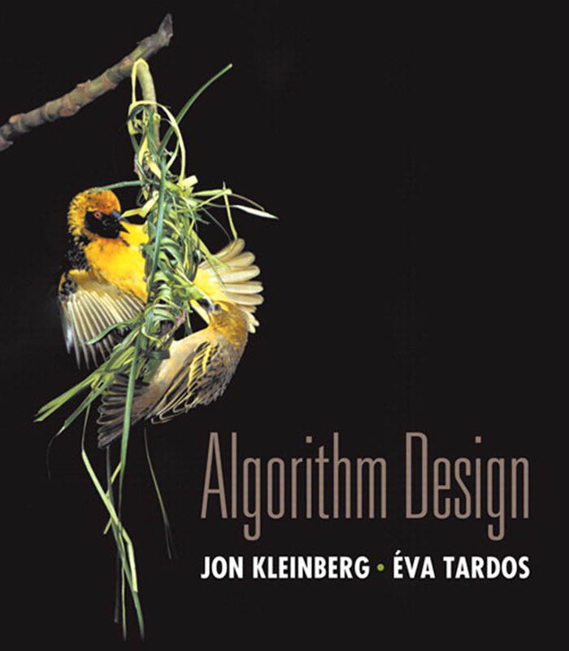

8. Intractability II
P vs. NP
NP-complete
co-NP
NP-hard
Lecture slides by Kevin Wayne Copyright © 2005 Pearson-Addison Wesley
http:// www.cs.princeton.edu/ ~wayne/ kleinberg-tardos
Last updated on 2/16/20 10:57 AM

Slide 2
Recap
3-SAT
ET
poly-time reduces
-S
AT
NDEPENDENT
3-S
to I
Independent-Set
Dir-Ham-Cycle
3-Color
Subset-Sum
Vertex-Cover
Ham-Cycle
Knapsack
Set-Cover
3-SAT poly-time reduces to all of these problems (and many, many more)
2

Slide 3


8. Intractability II
P vs. NP
NP-complete
co-NP
NP-hard
Section 8.3

Slide 4
・Problem X is a set of strings.
・Instance s is one string.
P
Decision problem.
・Algorithm A solves problem X :
yes if s ∈ X
no if s ∈/ X
A(s) =
Def. Algorithm A runs in polynomial time if for every string s, A(s)
terminates in ≤ p( ⎮s ⎮) “steps,” where p(⋅) is some polynomial function.
length of s
Def. P = set of decision problems for which there exists a poly-time algorithm.
on a deterministic Turing machine
problem PRIMES:
instance s: algorithm:
{ 2, 3, 5, 7, 11, 13, 17, 19, 23, 29, 31, … }
592335744548702854681
Agrawal–Kayal–Saxena (2002)

Slide 5



Some problems in P
P. Decision problems for which there exists a poly-time algorithm.
problem | description | poly-time algorithm | yes | no
Multiple | Is x a multiple of y ? | grade-school division | 51, 17 | 51, 16
Rel-Prime | Are x and y relatively prime ? | Euclid’s algorithm | 34, 39 | 34, 51
Primes | Is x prime ? | Agrawal–Kayal– Saxena | 53 | 51
Edit-Distance | Is the edit distance between x and y less than 5 ? | Needleman–Wunsch | niether neither | acgggt ttttta
L-Solve | Is there a vector x that satisfies Ax = b ? | Gauss–Edmonds elimination | ⎡ 0 1 1& ⎡ 4& ⎮ 2 4 −2⎮ , ⎮ 2⎮ ⎮ ⎮ ⎮ ⎮ ⎮⎣ 0 3 15⎮⎦ ⎮⎣36⎮⎦ | ⎡1 0 0% ⎡1% ⎮1 1 1⎮ , ⎮1⎮ ⎮ ⎮ ⎮ ⎮ ⎮⎣0 1 1⎮⎦ ⎮⎣1⎮⎦
U-Conn | Is an undirected graph G connected? | depth-first search

Slide 6
NP
Def. Algorithm C(s, t) is a certifier for problem X if for every string s :
s ∈ X iff there exists a string t such that C(s, t) = yes.
Def. NP = set of decision problems for which there exists a poly-time certifier.
・C(s, t) is a poly-time algorithm.
・Certificate t is of polynomial size:
⎮t ⎮ ≤ p(⎮s ⎮) for some polynomial p(⋅).
“certificate” or “witness”
problem COMPOSITES:
instance s: certificate t: certifier C(s, t):
{ 4, 6, 8, 9, 10, 12, 14, 15, 16, 18, 20, …. }
437669
541
437,669 = 541 × 809
grade-school division

Slide 7
Certifiers and certificates: satisfiability
SAT. Given a CNF formula Φ, does it have a satisfying truth assignment? 3-SAT. SAT where each clause contains exactly 3 literals.
Certificate. An assignment of truth values to the Boolean variables. Certifier. Check that each clause in Φ has at least one true literal.
Φ = ( x₁ ∨ x₂ ∨ x₃) ∧ ( x₁ ∨ x₂ ∨ x₃) ∧ ( x₁ ∨ x₂ ∨ x₄ )
instance s
certificate t
x1 = true, x2 = true, x3 = false, x4 = false
Conclusions. SAT ∈ NP, 3-SAT ∈ NP.

Slide 8


















Certifiers and certificates: Hamilton path
HAMILTON-PATH. Given an undirected graph G = (V, E), does there exist a simple path P that visits every node?
Certificate. A permutation π of the n nodes.
Certifier. Check that π contains each node in V exactly once,
and that G contains an edge between each pair of adjacent nodes.
instance s
certificate t
Conclusion. HAMILTON-PATH ∈ NP.

Slide 9





Some problems in NP
NP. Decision problems for which there exists a poly-time certifier.
problem | description | poly-time algorithm | yes | no
L-Solve | Is there a vector x that satisfies Ax = b ? | Gauss–Edmonds elimination | ⎡ 0 1 1& ⎡ 4& ⎮ 2 4 −2⎮ , ⎮ 2⎮ ⎮ ⎮ ⎮ ⎮ ⎣⎮ 0 3 15⎮⎦ ⎮⎣36⎮⎦ | ⎡1 0 0% ⎡1% ⎮1 1 1⎮ , ⎮1⎮ ⎮ ⎮ ⎮ ⎮ ⎮⎣0 1 1⎮⎦ ⎮⎣1⎮⎦
Composites | Is x composite ? | Agrawal–Kayal– Saxena | 51 | 53
Factor | Does x have a nontrivial factor less than y ? |  | (56159, 50) | (55687, 50)
Sat | Given a CNF formula, does it have a satisfying truth assignment? |  | ¬ x1 ∨ x2 ∨ ¬ x3 x1 ∨ ¬ x2 ∨ x3 ¬ x1 ∨ ¬ x2 ∨ x3 | ¬ x2 x1 ∨ x2 ¬ x1 ∨ x2
Hamilton- Path | Is there a simple path between u and v that visits every node?

Slide 10

Intractability: quiz 1
Which of the following graph problems are known to be in NP?
Is the length of the longest simple path ≤ k ?
Is the length of the longest simple path ≥ k ?
Is the length of the longest simple path = k ?
Find the length of the longest simple path.
All of the above.
10

Slide 11
Intractability: quiz 2
In complexity theory, the abbreviation NP stands for…
Nope.
No problem.
Not polynomial time.
Not polynomial space.
Nondeterministic polynomial time.
11

Slide 12
Significance of NP
NP. Decision problems for which there exists a poly-time certifier.
“ NP captures vast domains of computational, scientific, and mathematical endeavors, and seems to roughly delimit what mathematicians and scientists have been aspiring to compute feasibly. ” — Christos Papadimitriou
“ In an ideal world it would be renamed P vs VP. ” — Clyde Kruskal

Slide 13
P, NP, and EXP
P. Decision problems for which there exists a poly-time algorithm. NP. Decision problems for which there exists a poly-time certifier.
EXP. Decision problems for which there exists an exponential-time algorithm.
Proposition. P ⊆ NP.
Pf. Consider any problem X ∈ P.
・By definition, there exists a poly-time algorithm A(s) that solves X.
・Certificate t = ε, certifier C(s, t) = A(s). ▪
Proposition. NP ⊆ EXP.
Pf. Consider any problem X ∈ NP.
・By definition, there exists a poly-time certifier C(s, t) for X, where certificate t satisfies ⎮t ⎮ ≤ p(⎮s ⎮) for some polynomial p(⋅).
・To solve instance s, run C(s, t) on all strings t with ⎮t ⎮ ≤ p(⎮s ⎮).
・Return yes iff C(s, t) returns yes for any of these potential certificates. ▪
Fact. P ≠ EXP → either P ≠ NP, or NP ≠ EXP, or both.

Slide 14
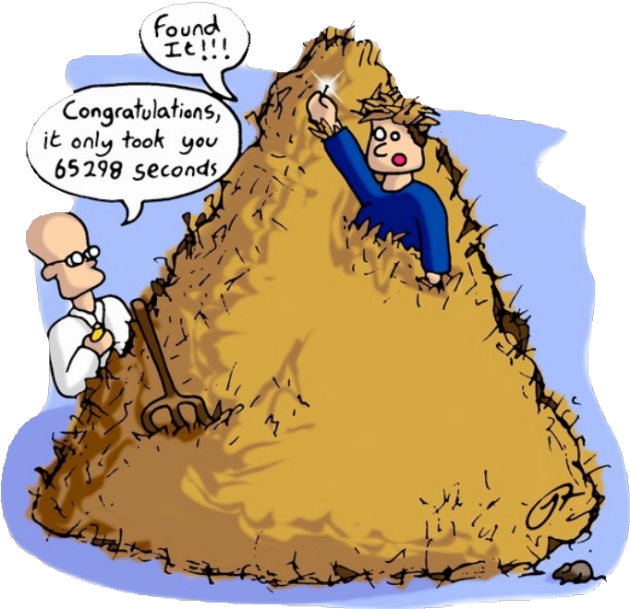
The main question: P vs. NP
Q. How to solve an instance of 3-SAT with n variables?
A. Exhaustive search: try all 2^{n} truth assignments.
Q. Can we do anything substantially more clever? Conjecture. No poly-time algorithm for 3-SAT.
“intractable”

Slide 15
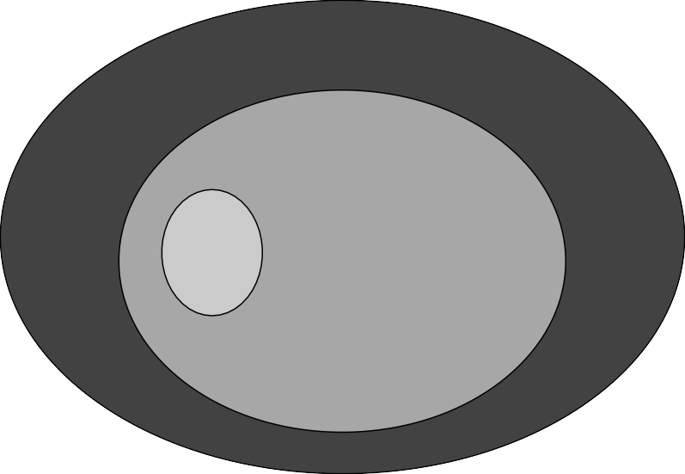
The main question: P vs. NP
Does P = NP? [Cook 1971, Edmonds, Levin, Yablonski, Gödel] Is the decision problem as easy as the certification problem?
EXP
EXP
NP
P = NP
P
If P = NP
If P ≠ NP
If yes… Efficient algorithms for 3-SAT, TSP, VERTEX-COVER, FACTOR, …
If no… No efficient algorithms possible for 3-SAT, TSP, VERTEX-COVER, …
Consensus opinion.
Probably no.

Slide 16
Reductions: quiz 3
Suppose P ≠ NP. Which of the following are still possible?
O(n³) algorithm for factoring n-bit integers.
O(1.657 ^{n}) time algorithm for HAMILTON-CYCLE.
O(n^{log log log n}) algorithm for 3-SAT.
All of the above.
16

Slide 17
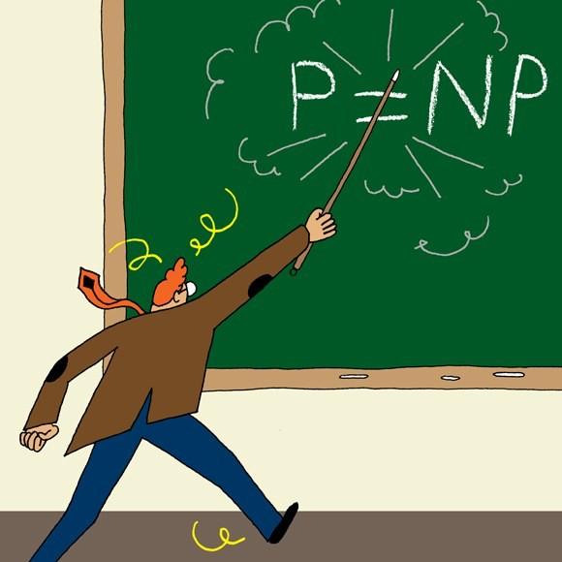
Intractability: quiz 4
Does P = NP?
Yes.
No.
None of the above.
17

Slide 18
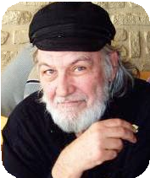

Possible outcomes
P ≠ NP
“ I conjecture that there is no good algorithm for the traveling salesman problem. My reasons are the same as for any mathematical conjecture:
(i) It is a legitimate mathematical possibility and (ii) I do not know.”
— Jack Edmonds 1966
“ In my view, there is no way to even make intelligent guesses about the answer to any of these questions. If I had to bet now, I would bet that P is not equal to NP. I estimate the half-life of this problem at 25–50 more years, but I wouldn’t bet on it being solved before 2100. ”
— Bob Tarjan (2002)

Slide 19
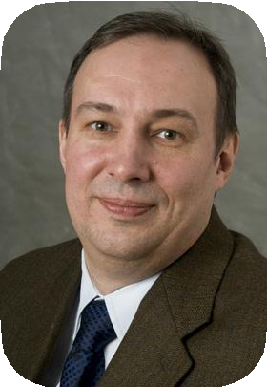
Possible outcomes
P ≠ NP
“ We seem to be missing even the most basic understanding of the nature of its difficulty…. All approaches tried so far probably (in some cases, provably) have failed. In this sense P =NP is different from many other major mathematical problems on which a gradual progress was being constantly done (sometimes for centuries) whereupon they yielded, either completely or partially. ”
— Alexander Razborov (2002)

Slide 20
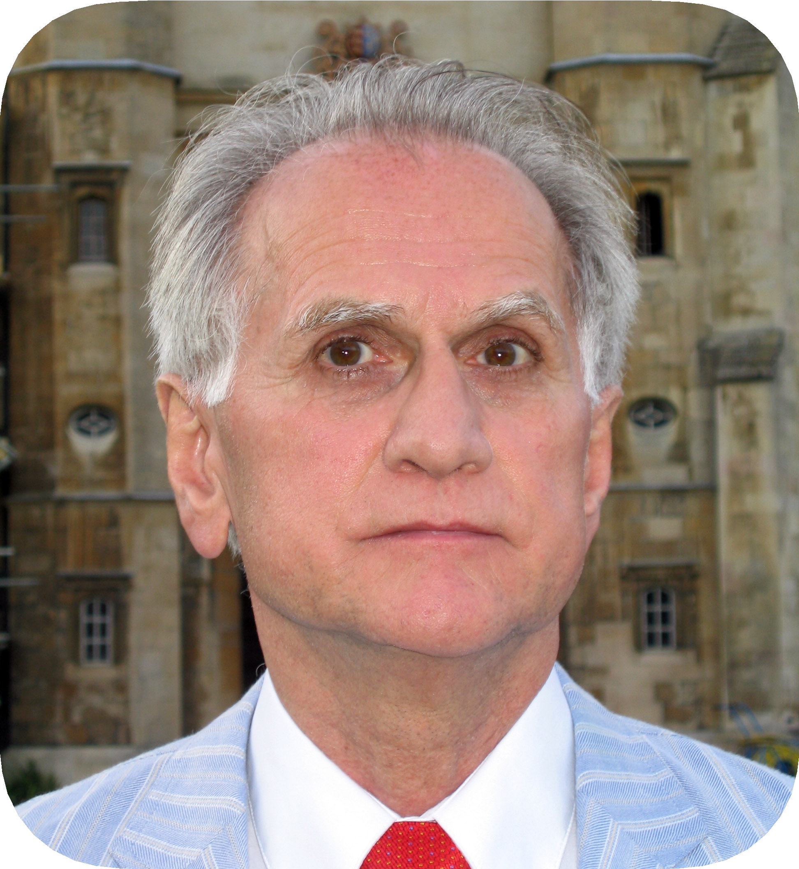
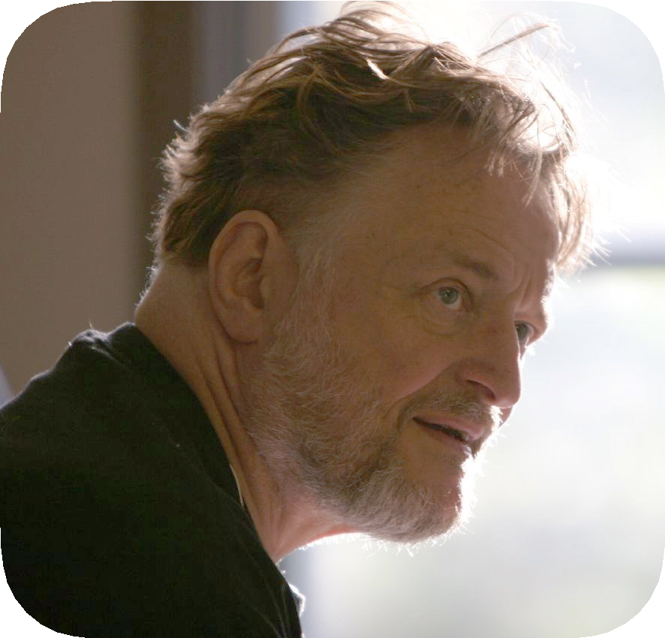
Possible outcomes
P = NP
“ I think that in this respect I am on the loony fringe of the mathematical community: I think (not too strongly!) that P=NP and this will be proved within twenty years. Some years ago, Charles Read and I worked on it quite bit, and we even had a celebratory dinner in a
good restaurant before we found an absolutely fatal mistake. ”
— Béla Bollobás (2002)
“ In my opinion this shouldn’t really be a hard problem; it’s just that we came late to this theory, and haven’t yet developed any
techniques for proving computations to be hard. Eventually, it will just be a footnote in the books. ” — John Conway

Slide 21
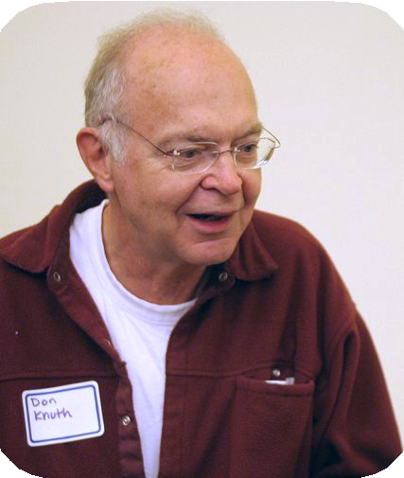
Other possible outcomes
P = NP, but only Ω(n¹⁰⁰) algorithm for 3-SAT.
P ≠ NP, but with O(n^{log*n}) algorithm for 3-SAT.
P = NP is independent (of ZFC axiomatic set theory).
“ It will be solved by either 2048 or 4096. I am currently somewhat pessimistic. The outcome will be the truly worst case scenario: namely that someone will prove P = NP because there are only finitely many obstructions to the opposite hypothesis; hence there exists a polynomial time solution to SAT but we will never know its complexity! ” — Donald Knuth

Slide 22
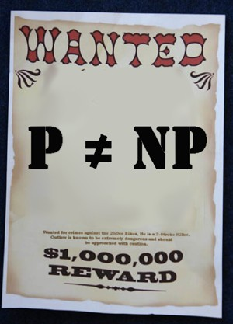
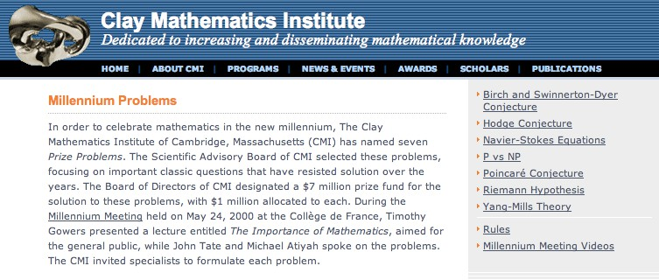
Millennium prize
Millennium prize. $1 million for resolution of P ≠ NP problem.

Slide 23
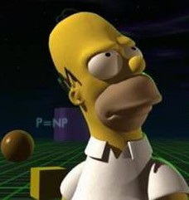



P vs. NP and pop culture
Some writers for the Simpsons and Futurama.
・J. Steward Burns. M.S. in mathematics (Berkeley ’93).
・David X. Cohen. M.S. in computer science (Berkeley ’92).
・Al Jean. B.S. in mathematics. (Harvard ’81).
・Ken Keeler. Ph.D. in applied mathematics (Harvard ’90).
・Jeff Westbrook. Ph.D. in computer science (Princeton ’89).
Copyright © 1990, Matt Groening
Copyright © 2000, Twentieth Century Fox

Slide 24
8. Intractability II
P vs. NP
NP-complete
co-NP
NP-hard
Section 8.4

Slide 25
Polynomial transformations
Def. Problem X polynomial (Cook) reduces to problem Y if arbitrary instances of problem X can be solved using:
・Polynomial number of standard computational steps, plus
・Polynomial number of calls to oracle that solves problem Y.
Def. Problem X polynomial (Karp) transforms to problem Y if given any instance x of X, we can construct an instance y of Y such that x is a yes instance of X iff y is a yes instance of Y.
we require ⎮y ⎮ to be of size polynomial in ⎮x ⎮
Note. Polynomial transformation is polynomial reduction with just one call to oracle for Y, exactly at the end of the algorithm for X. Almost all previous reductions were of this form.
Open question. Are these two concepts the same with respect to NP?
we abuse notation ≤ _{P} and blur distinction

Slide 26
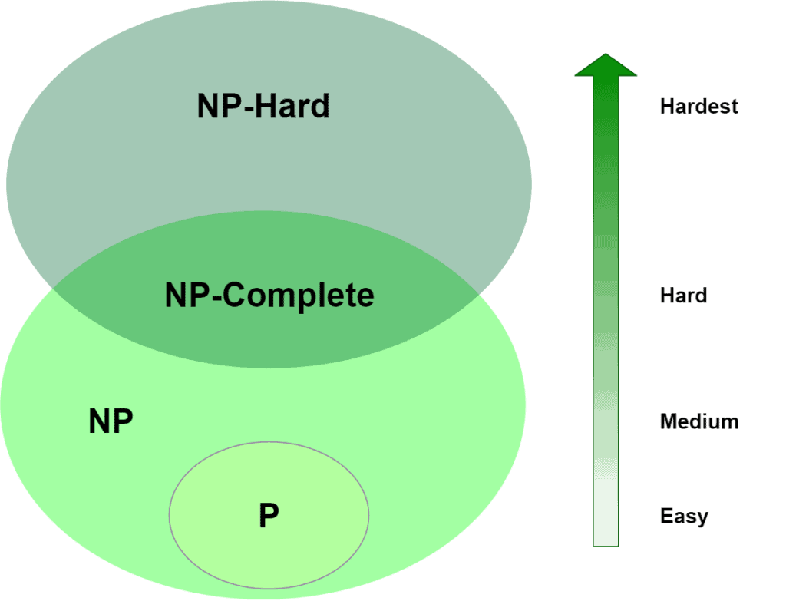
NP-complete
NP-complete. A problem Y ∈ NP with the property that for every problem X ∈ NP, X ≤ _{P} Y.
Proposition. Suppose Y ∈ NP-complete. Then, Y ∈ P iff P = NP. Pf. ⇐ If P = NP, then Y ∈ P because Y ∈ NP.
Pf. ⇒ Suppose Y ∈ P.
・Consider any problem X ∈ NP. Since X ≤ P Y, we have X ∈ P.
・This implies NP ⊆ P.
・We already know P ⊆ NP. Thus P = NP. ▪

Slide 27
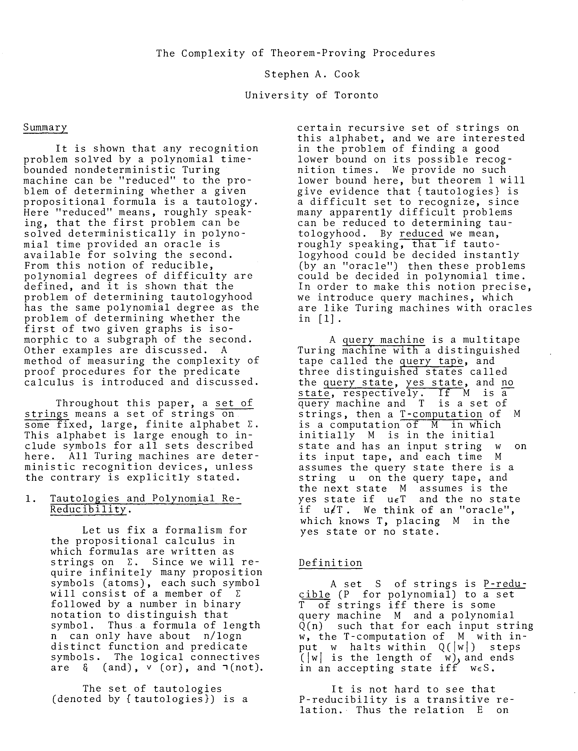
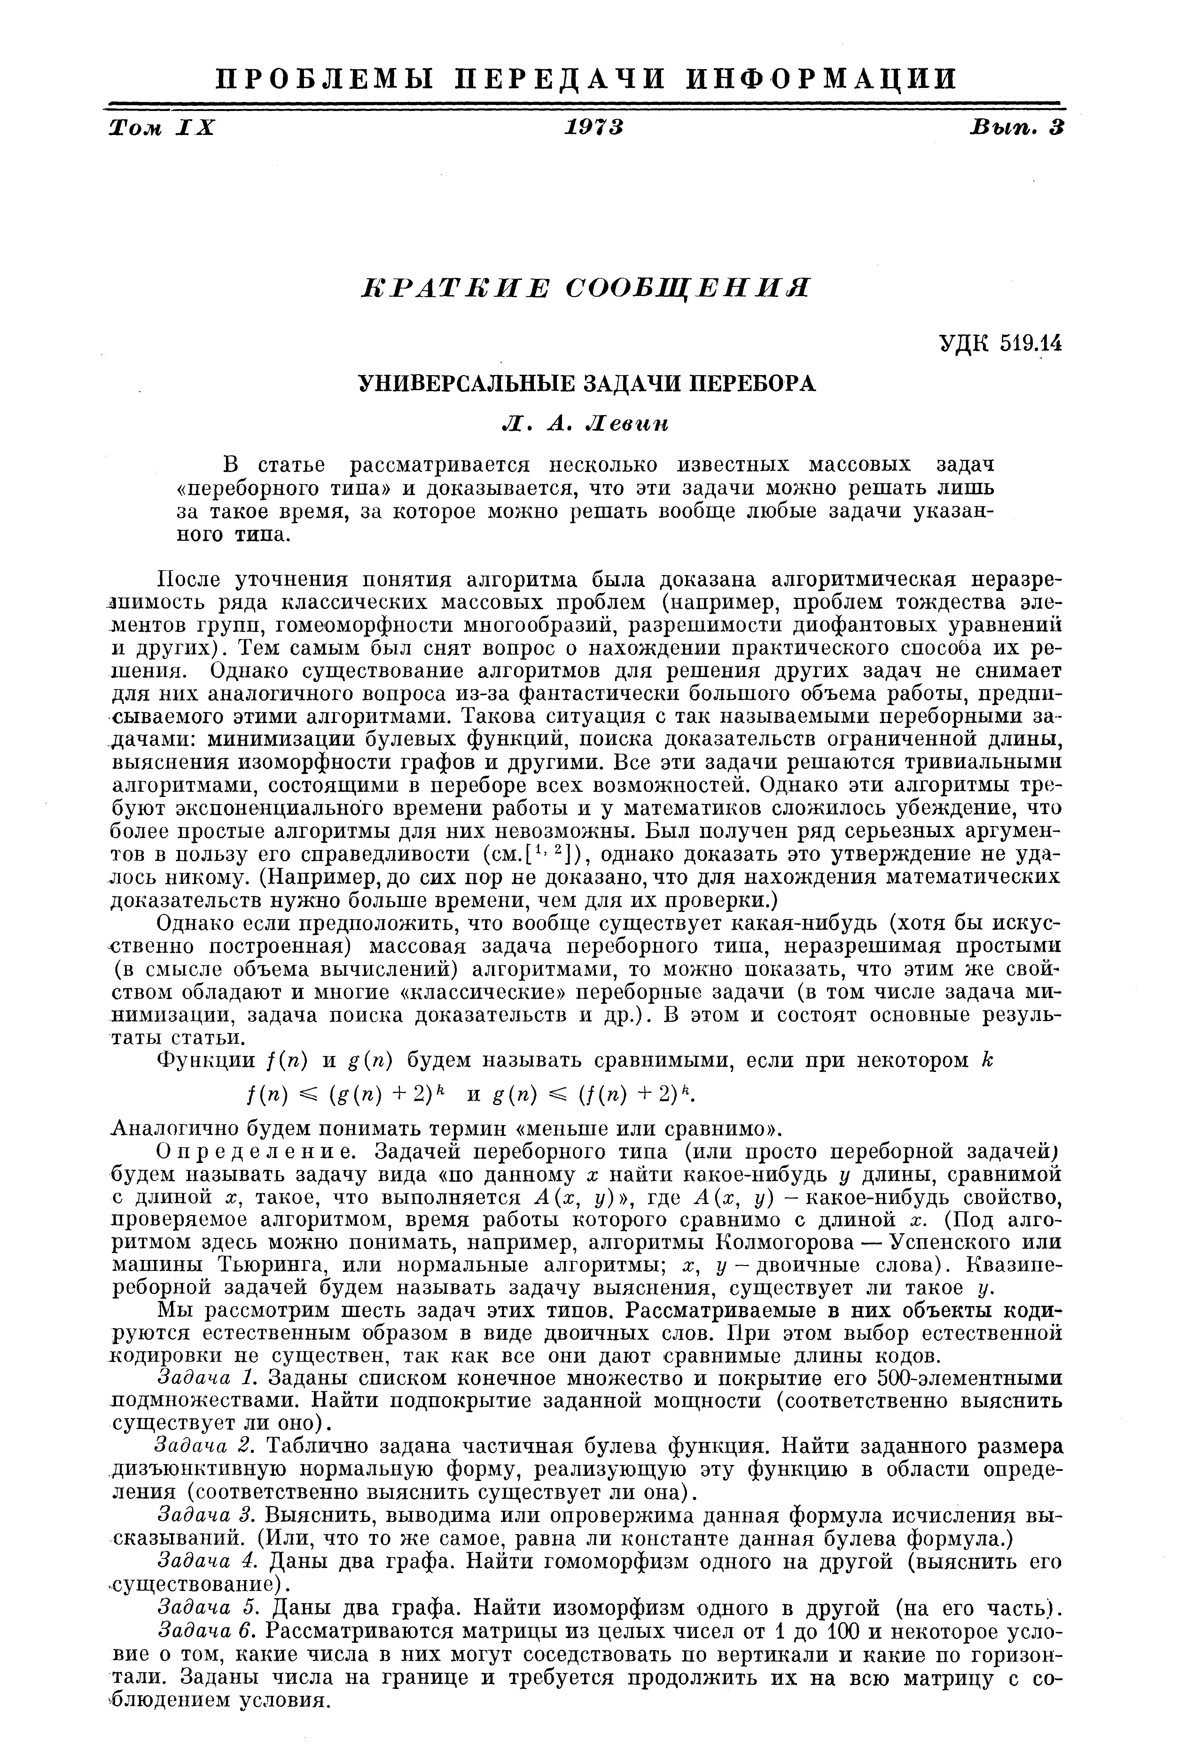
The “first” NP-complete problem
Theorem. [Cook 1971, Levin 1973] SAT ∈ NP-complete.

Slide 28
Establishing NP-completeness
Remark. Once we establish first “natural” NP-complete problem, others fall like dominoes.
Recipe. To prove that Y ∈ NP-complete:
・Step 1. Show that Y ∈ NP.
・Step 2. Choose an NP-complete problem X.
・Step 3. Prove that X ≤ _{P} Y.
Proposition. If X ∈ NP-complete, Y ∈ NP, and X ≤ _{P} Y, then Y ∈ NP-complete. Pf. Consider any problem W ∈ NP. Then, both W ≤ _{P} X and X ≤ _{P} Y.
・By transitivity, W ≤ _{P} Y.
・Hence Y ∈ NP-complete. ▪
by definition of
NP-complete
by assumption

Slide 29
Reductions: quiz 4
Suppose that X ∈ NP-COMPLETE, Y ∈ NP, and X ≤ _{P} Y. Which can you infer?
Y is NP-complete.
If Y ∉ P, then P ≠ NP.
If P ≠ NP, then neither X nor Y is in P.
All of the above.
recipe for proving that Y is NP-complete
Y is NP-complete
X and Y are NP-complete
31

Slide 30
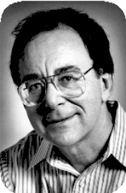
Implications of Karp
Sat
3-SAT
poly-time reduces
-S
ET
3-S
AT
NDEPENDENT
to I
Independent-Set
Dir-Ham-Cycle
3-Color
Subset-Sum
Vertex-Cover
Ham-Cycle
Knapsack
SAT poly-time reduces to all of these problems (and many, many more)
Set-Cover

Slide 31
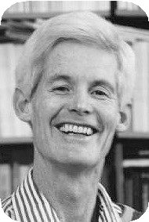
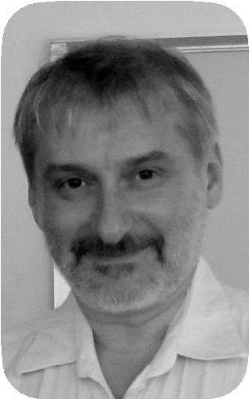
Implications of Cook–Levin
Sat
-S
ET
NDEPENDENT
-S
AT
3-SAT
poly-time reduces
I
IRCUIT
to C
Independent-Set
Dir-Ham-Cycle
3-Color
Subset-Sum
Vertex-Cover
Ham-Cycle
Knapsack
All of these problems (and many, many more) poly-time reduce to SAT.
Set-Cover

Slide 32
Implications of Karp + Cook–Levin
Sat
-S
ET
3-SAT
NDEPENDENT
and I
poly-time reduce to
3-S
AT
one another
Independent-Set
Dir-Ham-Cycle
3-Color
Subset-Sum
Vertex-Cover
Ham-Cycle
Knapsack
All of these problems are NP-complete; they are manifestations of the same really hard problem.
Set-Cover

Slide 33
I’D TELL YOU ANOTHER
NP-COMPLETE JOKE, BUT ONCE YOU’VE HEARD
ONE,
YOU’VE HEARD THEM ALL.

Slide 34
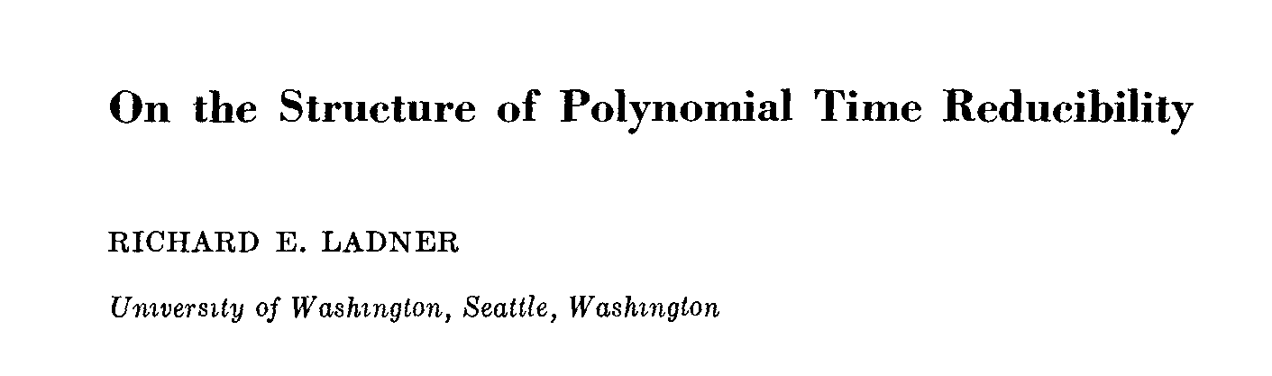
Some NP-complete problems
Basic genres of NP-complete problems and paradigmatic examples.
・Packing/covering problems: SET-COVER, VERTEX-COVER,INDEPENDENT-SET.
・Constraint satisfaction problems: CIRCUIT-SAT, SAT, 3-SAT.
・Sequencing problems: HAMILTON-CYCLE, TSP.
・Partitioning problems: 3D-MATCHING, 3-COLOR.
・Numerical problems: SUBSET-SUM, KNAPSACK.
Practice. Most NP problems are known to be either in P or NP-complete. NP-intermediate? FACTOR, DISCRETE-LOG, GRAPH-ISOMORPHISM, ….
Theorem. [Ladner 1975] Unless P = NP, there exist problems in NP that are neither in P nor NP-complete.

Slide 35
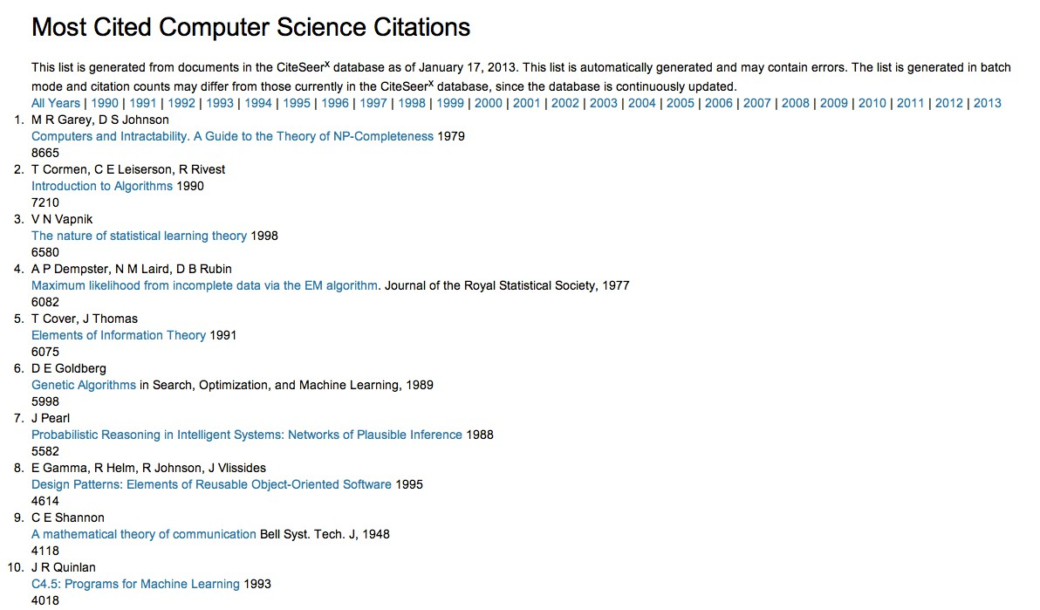
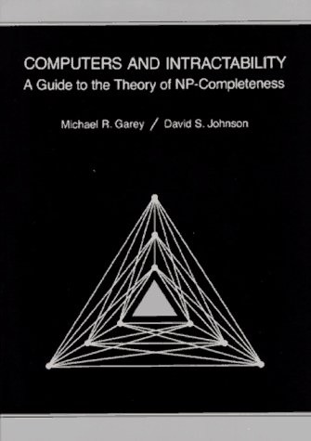
More hard computational problems
Garey and Johnson. Computers and Intractability.
・Appendix includes over 300 NP-complete problems.
・Most cited reference in computer science literature.

Slide 36
More hard computational problems
Aerospace engineering. Optimal mesh partitioning for finite elements. Biology. Phylogeny reconstruction.
Chemical engineering. Heat exchanger network synthesis. Chemistry. Protein folding.
Civil engineering. Equilibrium of urban traffic flow.
Economics. Computation of arbitrage in financial markets with friction. Electrical engineering. VLSI layout.
Environmental engineering. Optimal placement of contaminant sensors. Financial engineering. Minimum risk portfolio of given return.
Game theory. Nash equilibrium that maximizes social welfare.
Mathematics. Given integer a1, …, an, compute
Mechanical engineering. Structure of turbulence in sheared flows. Medicine. Reconstructing 3d shape from biplane angiocardiogram. Operations research. Traveling salesperson problem.
Physics. Partition function of 3d Ising model. Politics. Shapley–Shubik voting power.
Recreation. Versions of Sudoku, Checkers, Minesweeper, Tetris, Rubik’s Cube. Statistics. Optimal experimental design.

Slide 37
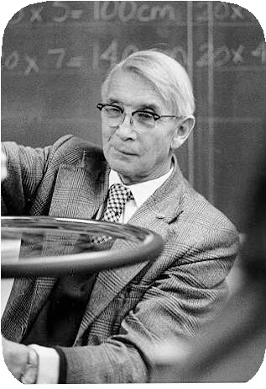
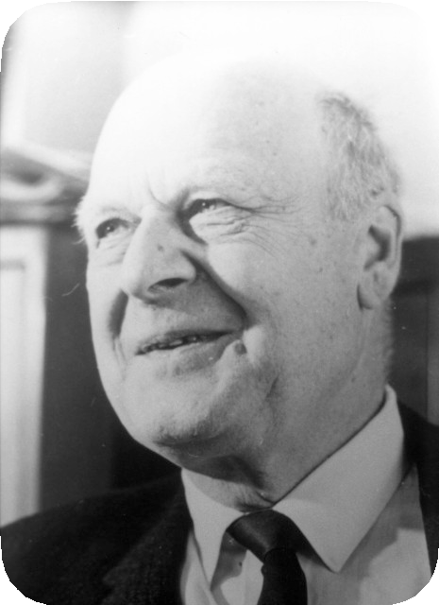
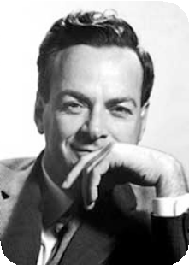

Extent and impact of NP-completeness
Extent of NP-completeness. [Papadimitriou 1995]
・Prime intellectual export of CS to other disciplines.
・6,000 citations per year (more than “compiler”, “OS”, “database”).
・Broad applicability and classification power.
NP-completeness can guide scientific inquiry.
・1926: Ising introduces simple model for phase transitions.
・1944: Onsager finds closed-form solution to 2D-ISING in tour de force.
・19xx: Feynman and other top minds seek solution to 3D-ISING.
・2000: Istrail proves 3D-ISING ∈ NP-complete.
a holy grail of statistical mechanics
search for closed formula appears doomed

Slide 38

You NP-complete me
网络视频
https://www.youtube.com/watch?v=YX40hbAHx3s
温馨提示：此视频框在点击“上传手机课件”时会进行转换，用手机进行观看时则会变为可点击的视频。此视频框可被拖动移位和修改大小。

Slide 39
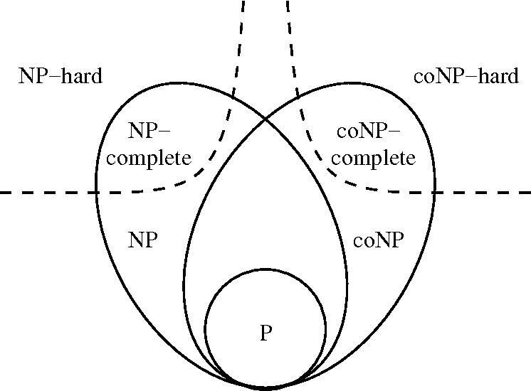
8. Intractability II
P vs. NP
NP-complete
co-NP
NP-hard
Section 8.9

Slide 40
Asymmetry of NP
Asymmetry of NP. We need short certificates only for yes instances.
Ex 1. SAT vs. UN-SAT.
・Can prove a CNF formula is satisfiable by specifying an assignment.
・How could we prove that a formula is not satisfiable?
SAT. Given a CNF formula Φ, is there a satisfying truth assignment?
UN-SAT. Given a CNF formula Φ, is there no satisfying truth assignment?

Slide 41


Asymmetry of NP
Asymmetry of NP. We need short certificates only for yes instances.
Ex 2. HAMILTON-CYCLE vs. NO-HAMILTON-CYCLE.
・Can prove a graph is Hamiltonian by specifying a permutation.
・How could we prove that a graph is not Hamiltonian?
HAMILTON-CYCLE. Given a graph G = (V, E), is there a simple cycle Γ that contains every node in V ?
NO-HAMILTON-CYCLE. Given a graph G = (V, E), is there no simple cycle Γ that contains every node in V ?

Slide 42
Asymmetry of NP
Asymmetry of NP. We need short certificates only for yes instances.
Q. How to classify UN-SAT and NO-HAMILTON-CYCLE ?
・SAT ∈ NP-complete and SAT ≡ P UN-SAT.
・HAMILTON-CYCLE ∈ NP-complete and HAMILTON-CYCLE ≡ P NO-HAMILTON-CYCLE.
・But neither UN-SAT nor NO-HAMILTON-CYCLE are known to be in NP.

Slide 43
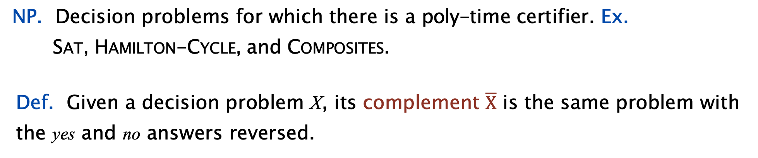
NP and co-NP
NP. Decision problems for which there is a poly-time certifier. Ex. SAT, HAMILTON-CYCLE, and COMPOSITES.
Def. Given a decision problem X, its complement $\overline{X}$ is the same problem with the yes and no answers reversed.
Ex. X = { 4, 6, 8, 9, 10, 12, 14, 15, … }
ignore 0 and 1 (neither prime nor composite)
X = { 2, 3, 5, 7, 11, 13, 17, 23, 29, … }
co-NP. Complements of decision problems in NP. Ex. UN-SAT, NO-HAMILTON-CYCLE, and PRIMES.

Slide 44
NP = co-NP ?
Fundamental open question. Does NP = co-NP?
・Do yes instances have succinct certificates iff no instances do?
・Consensus opinion: no.
Theorem. If NP ≠ co-NP, then P ≠ NP. Pf idea.
・P is closed under complementation.
・If P = NP, then NP is closed under complementation.
・In other words, NP = co-NP.
・This is the contrapositive of the theorem.

Slide 45
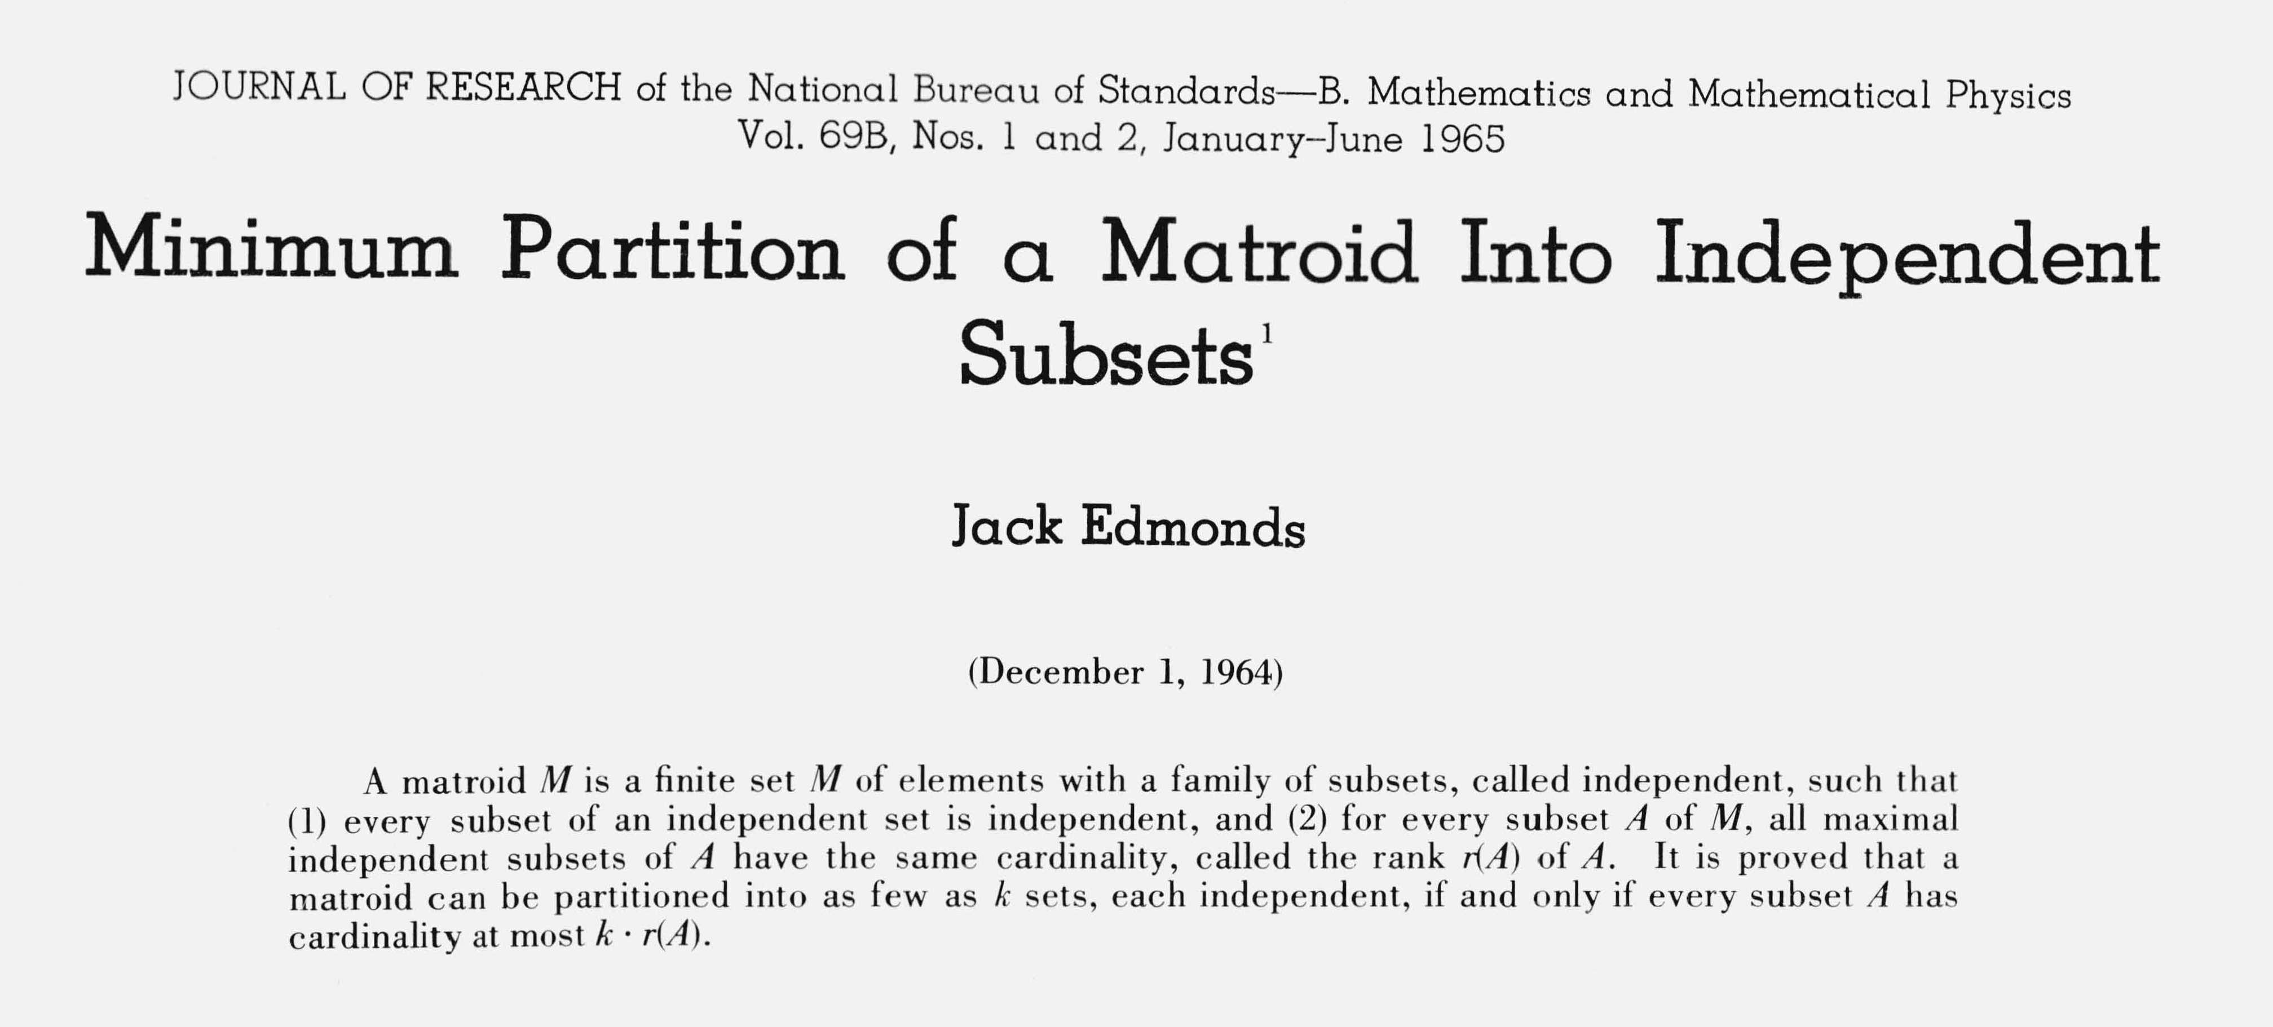
Good characterizations (tend to be easier)
Good characterization. [Edmonds 1965] NP Ω co-NP.
・If problem X is in both NP and co-NP, then:
-
-
for yes instance, there is a succinct certificate
for no instance, there is a succinct disqualifier
・Provides conceptual leverage for reasoning about a problem.
Ex. Given a bipartite graph, is there a perfect matching?
・If yes, can exhibit a perfect matching.
・If no, can exhibit a set of nodes S such that | neighbors(S) | < | S |.

Slide 46
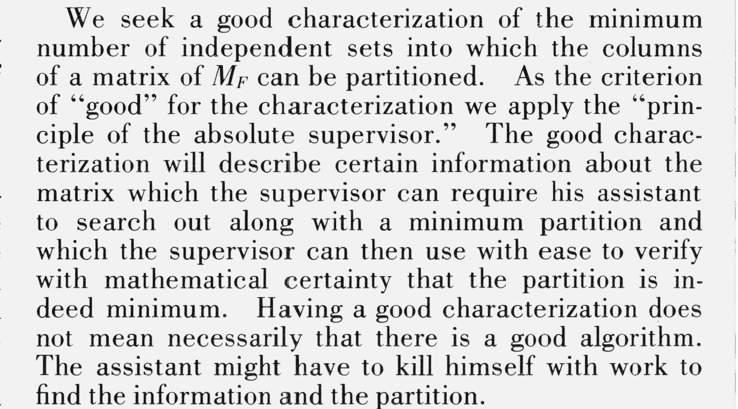
Good characterizations

Slide 47
Good characterizations
Observation. P ⊆ NP Ω co-NP.
・Proof of max-flow min-cut theorem led to stronger result that max-flow and min-cut are in P.
・Sometimes finding a good characterization seems easier than finding an efficient algorithm.
Fundamental open question. Does P = NP Ω co-NP?
・Mixed opinions.
・Many examples where problem found to have a nontrivial good characterization, but only years later discovered to be in P.

Slide 48
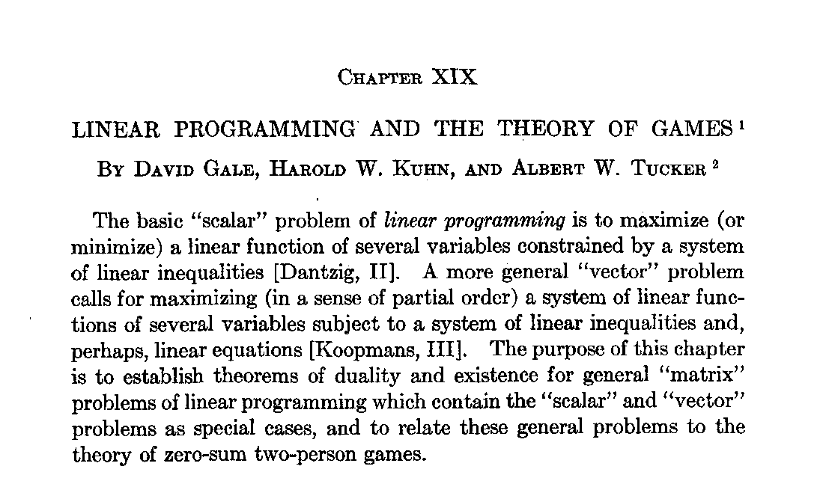
Linear programming is in NP Ω co-NP
LINEAR-PROGRAMMING. Given A ∈ ℜ^{m×n}, b ∈ ℜ^{m}, c ∈ ℜ^{n}, and α ∈ ℜ, does there exist x ∈ ℜ^{n} such that Ax ≤ b, x ≥ 0 and c^{T} x ≥ α ?
Theorem. [Gale–Kuhn–Tucker 1948] LINEAR-PROGRAMMING ∈ NP Ω co-NP. Pf sketch. If (P) and (D) are nonempty, then max = min.
(P) max c^{T} x
s. t. Ax ≤ b
x ≥ 0
(D) min y^{T} b
s. t.
A^{T} y ≥ c
y ≥ 0

Slide 49
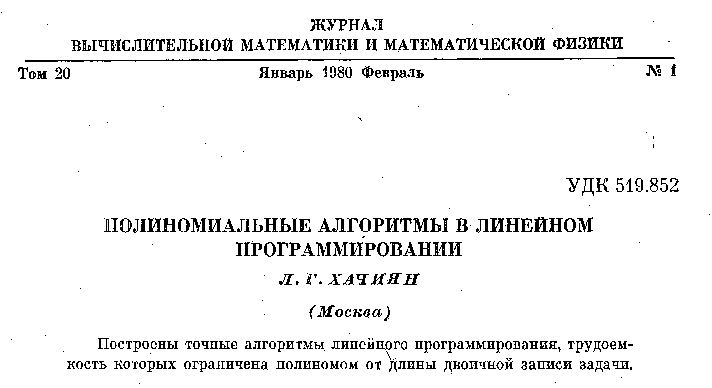
Linear programming is in NP Ω co-NP
LINEAR-PROGRAMMING. Given A ∈ ℜ^{m×n}, b ∈ ℜ^{m}, c ∈ ℜ^{n}, and α ∈ ℜ, does there exist x ∈ ℜ^{n} such that Ax ≤ b, x ≥ 0 and c^{T} x ≥ α ?
Theorem. [Khachiyan 1979] LINEAR-PROGRAMMING ∈ P.

Slide 50
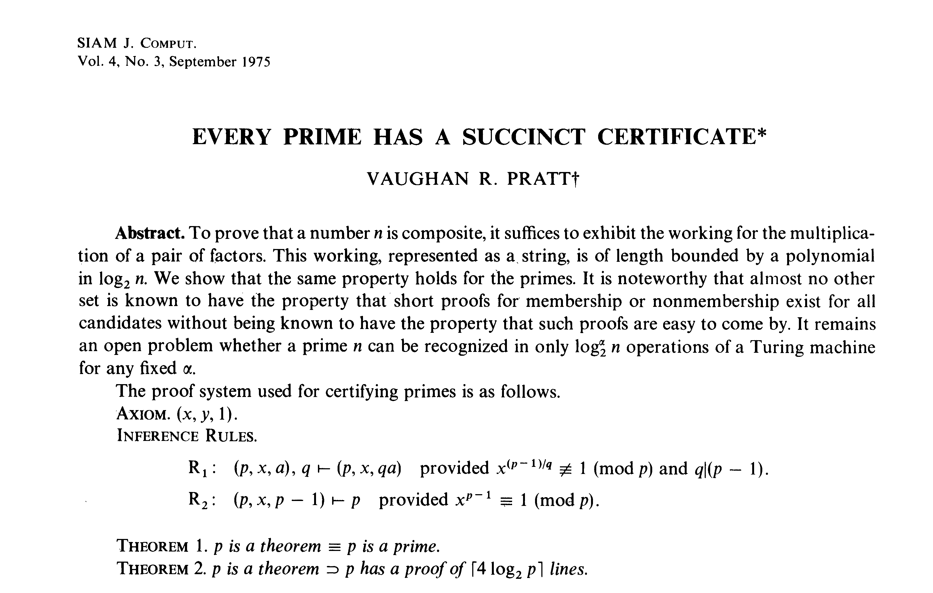
Primality testing is in NP Ω co-NP
Theorem. [Pratt 1975] PRIMES ∈ NP Ω co-NP.

Slide 51
Primality testing is in NP Ω co-NP
Theorem. [Pratt 1975] PRIMES ∈ NP Ω co-NP.
Pf sketch. An odd integer s is prime iff there exists an integer 1 < t < s s.t.
_{t} s−1
_{t}(s−1) / p
≡ 1 (mod s)
≠ 1 (mod s)
for all prime divisors p of s-1
437677
17, 2² × 3 × 36473
Certifier (s)
CHECK s – 1 = 2 × 2 × 3 × 36473. CHECK 17^{s–1} = 1 (mod s).
CHECK 17^{(s–1) / 2} ≡ 437676 (mod s). CHECK 17^{(s–1) / 3} ≡ 329415 (mod s). CHECK 17^{(s–1) / 36,473} ≡ 305452 (mod s).
instance s
certificate t
prime factorization of s–1 also need a recursive certificate
to assert that 3 and 36,473 are prime
use repeated squaring

Slide 52
Primality testing is in P
Theorem. [Agrawal–Kayal–Saxena 2004] PRIMES ∈ P.
Annals of Mathematics, 160 (2004), 781–793
PRIMES is in P
By Manindra Agrawal, Neeraj Kayal, and Nitin Saxena*
Abstract
We present an unconditional deterministic polynomial-time algorithm that determines whether an input number is prime or composite.

Slide 53
Factoring is in NP Ω co-NP
FACTORIZE. Given an integer x, find its prime factorization.
FACTOR. Given two integers x and y, does x have a nontrivial factor < y ?
Theorem. FACTOR ≡ P FACTORIZE.
Pf.
・≤ P
・≥ P
trivial.
binary search to find a factor; divide out the factor and repeat. ▪
Theorem. FACTOR ∈ NP Ω co-NP. Pf.
・Certificate: a factor p of x that is less than y.
・Disqualifier: the prime factorization of x (where each prime factor is less than y), along with a Pratt certificate that each factor is prime. ▪

Slide 54
Is factoring in P ?
Fundamental question. Is FACTOR ∈ P ?
Challenge. Factor this number.
74037563479561712828046796097429573142593188889231289
08493623263897276503402826627689199641962511784399589
43305021275853701189680982867331732731089309005525051
16877063299072396380786710086096962537934650563796359
RSA-704
($30,000 prize if you can factor)

Slide 55
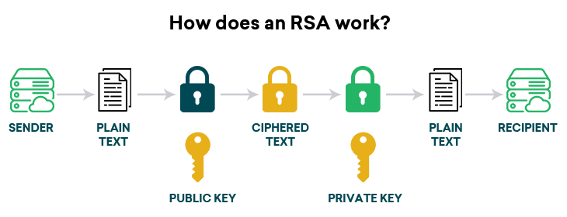
Exploiting intractability
Modern cryptography.
・Ex. Send your credit card number to Amazon.
・Ex. Digitally sign an e-document.
・Enables freedom of privacy, speech, press, political association.
RSA. Based on dichotomy between complexity of two problems.
・To use: generate two random n-bit primes and multiply.
・To break: suffices to factor a 2n-bit integer.

Slide 56
How does Digital Signatures work?
网络视频
https://www.youtube.com/watch?v=JR4_RBb8A9Q
温馨提示：此视频框在点击“上传手机课件”时会进行转换，用手机进行观看时则会变为可点击的视频。此视频框可被拖动移位和修改大小。

Slide 57

Factoring on a quantum computer
Theorem. [Shor 1994] Can factor an n-bit integer in O(n³) steps on a “quantum computer.”
SIAM REVIEW
Vol. 41, No. 2, pp. 303–332
∞c 1999 Society for Industrial and Applied Mathematics
Polynomial-Time Algorithms for Prime Factorization and Discrete Logarithms on a Quantum Computer§
Peter W. Shor†
Abstract. A digital computer is generally believed to be an e±cient universal computing device; that is, it is believed to be able to simulate any physical computing device with an increase in computation time by at most a polynomial factor. This may not be true when quantum mechanics is taken into consideration. This paper considers factoring integers and finding discrete logarithms, two problems that are generally thought to be hard on classical com- puters and that have been used as the basis of several proposed cryptosystems. E±cient randomized algorithms are given for these two problems on a hypothetical quantum com- puter. These algorithms take a number of steps polynomial in the input size, for example, the number of digits of the integer to be factored.
2001. Factored 15 = 3 ! 5 (with high probability) on a quantum computer. 2012. Factored 21 = 3 ! 7.
Fundamental question. Does P = BQP ?
quantum analog of P
(bounded error quantum polynomial time)
58

Slide 58
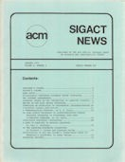
8. Intractability II
P vs. NP
NP-complete
co-NP
NP-hard

Slide 59
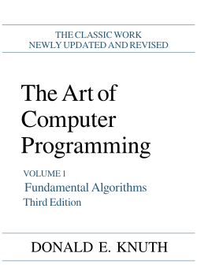
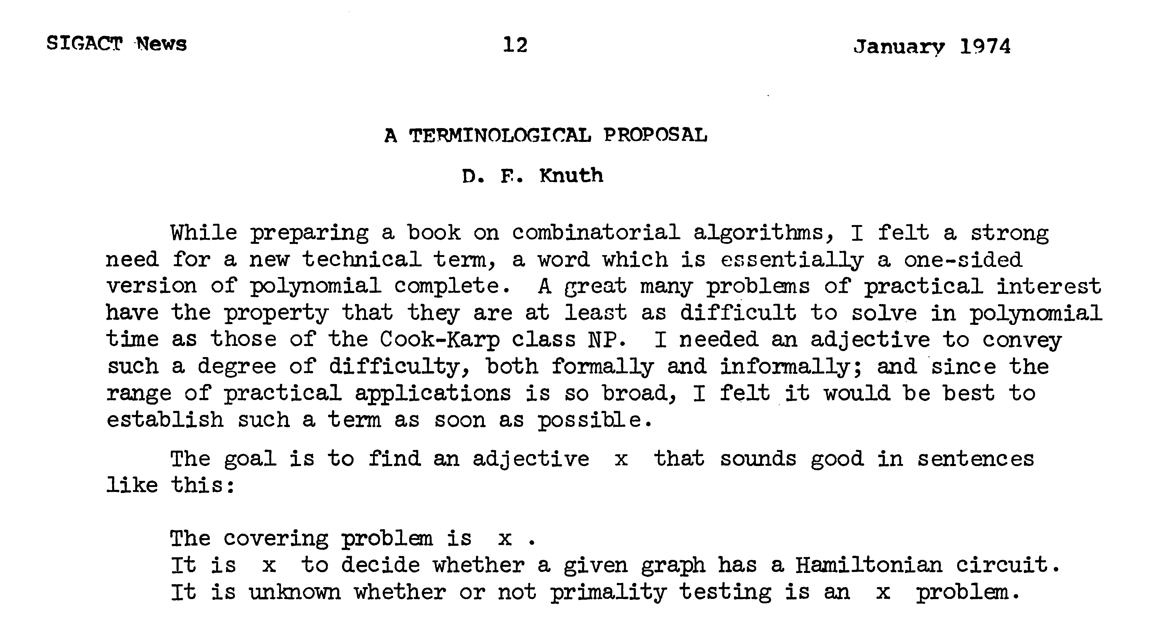
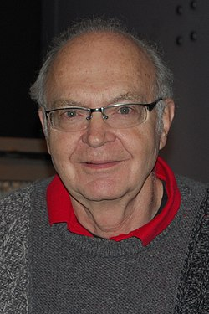
A note on terminology
Note. The term x does not necessarily imply that a problem is in NP, just that every problem in NP poly-time reduces to x.

Slide 60
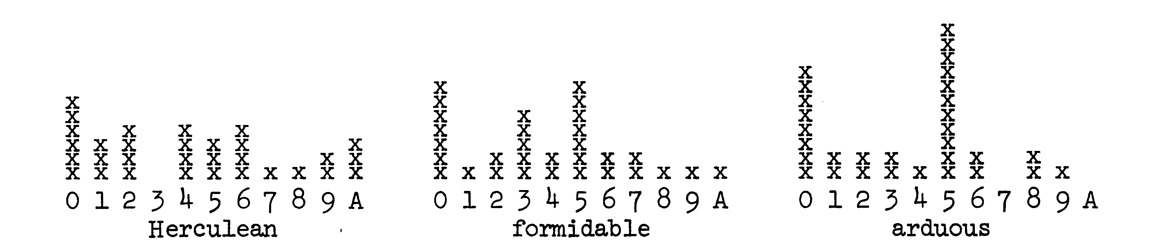
A note on terminology
Knuth’s original suggestions.
・Hard.
・Tough.
so common that it is unclear whether it is being used in a technical sense
・Herculean.
・Formidable.
・Arduous.
assign a real number between 0 and 1 to each choice

Slide 61
A note on terminology
Some English word write-ins.
・Impractical.
・Bad.
・Heavy.
・Tricky.
・Intricate.
・Prodigious.
・Difficult.
・Intractable.
・Costly.
・Obdurate.
・Obstinate.
・Exorbitant.
・Interminable.

Slide 62
A note on terminology
Hard-boiled. [Ken Steiglitz] In honor of Cook.
Hard-ass. [Al Meyer] Hard as satisfiability.
Sisyphean. [Bob Floyd] Problem of Sisyphus was time-consuming. Ulyssean. [Donald Knuth] Ulysses was known for his persistence.
“ creative research workers are as full of ideas for new terminology as they are empty of enthusiasm for adopting it. ”
— Donald Knuth

Slide 63
A note on terminology: acronyms
PET. [Shen Lin] Probably exponential time.
・If P ≠ NP, provably exponential time.
・If P = NP, previously exponential time.
GNP. [Al Meyer] Greater than or equal to NP in difficulty.
・And costing more than the GNP to solve.

Slide 64
A note on terminology: made-up words
Exparent. [Mike Paterson] Exponential + apparent.
Perarduous. [Mike Paterson] Throughout (in space or time) + completely. Supersat. [Al Meyer] Greater than or equal to satisfiability.
Polychronious. [Ed Reingold] Enduringly long; chronic.

Slide 65
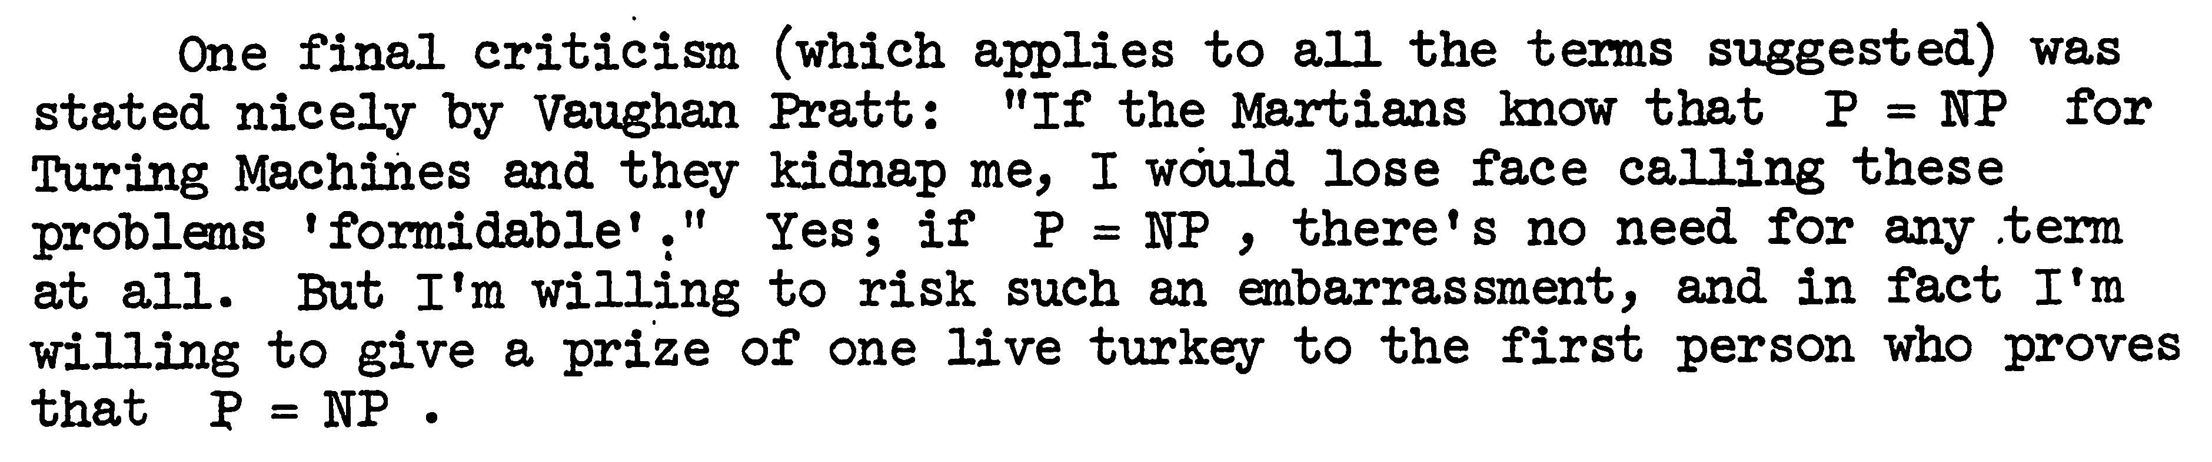
A note on terminology: consensus
NP-complete. A problem in NP such that every problem in NP poly-time reduces to it.
NP-hard. [Bell Labs, Steve Cook, Ron Rivest, Sartaj Sahni]
A problem such that every problem in NP poly-time reduces to it.

